Slide 1
Cardzo – Document Tools App
Document Tools
&
EBookReader
Team
Sidharth CS
Praveen Kumar
Jyothis KS
Krishnendu Suresh
Jabirhusain KP

Slide 2
Contents
Introduction
Project Objectives
Modules Introduction – DocScanner, DocTools, Ereader
Software Requirements
Context Diagrams

Slide 3
Introduction
The Cardzo app will give the user pretty much every features regarding managing documents like converting, creating, viewing documents along with an epub reader to make it easy to read books from our smartphone device.

Slide 4
Project Objective
To create an interactive android app which provides :
A Document Scanner to create pdfs from images
Document tools like Convertor, Compressor, etc..
Ebook Reader

Slide 5
What We Are Using?
Front-end
  Flutter
    Mobile UI Development Framework by Google
    Primary language : Dart
Back-end
  Python Django
    Web Development Framework
    Primary Language : Python

Slide 6
DocScanner
Functionalities :
Creating a document from given image
Displaying PDF Documents
Allow User to share the created documents

Slide 7
DocTools
Functionalities :
Compress Documents
Convert Documents to Another Format
PDF Splitter and Joiner

Slide 8
EReader
Functionalities :
Display Epub formatted Ebooks
Provides Night mode
Other functions like adjusting scroll and font size

Slide 9
Translator Module
Functionalities :
Getting Text from Typed Images using OCR
Translation of the text to other languages

Slide 10
Software Requirements
• Platform :
◦ Android
• Operating System :
◦ Android – Version 6.0 above ( API 23 above )
• Hardware :
◦ Smartphone should have camera
◦ at least 2GB RAM

Slide 11
Software Requirements
Developer Side
Android SDK 27 ( Android 8.1 )
Android Studio / VS Code
Flutter SDK
Hardware Permissions Needed
    Camera Access
    Network Access

Slide 12
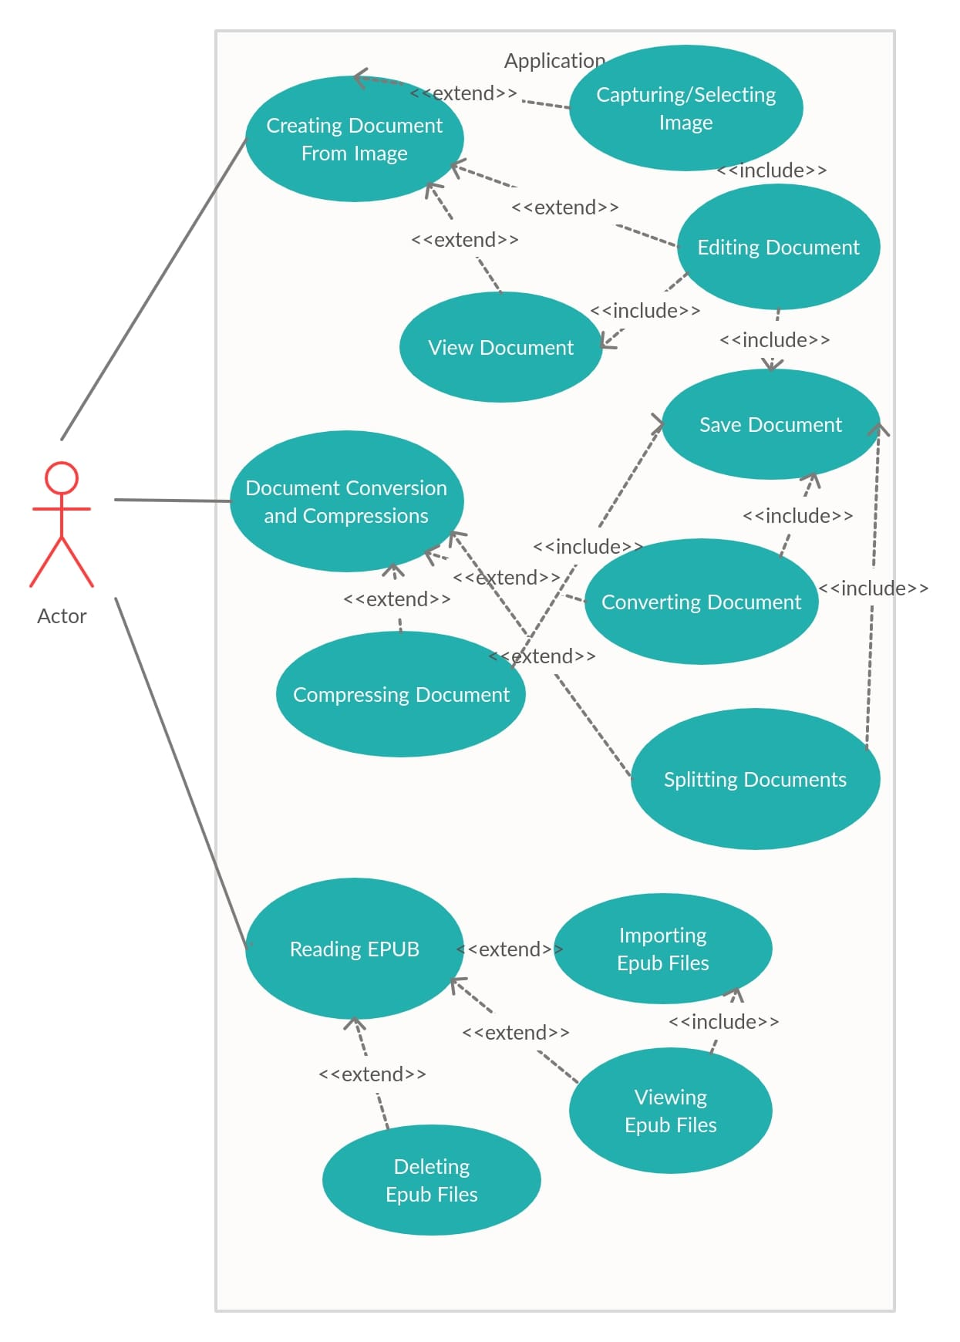
UseCase Diagram

Slide 13
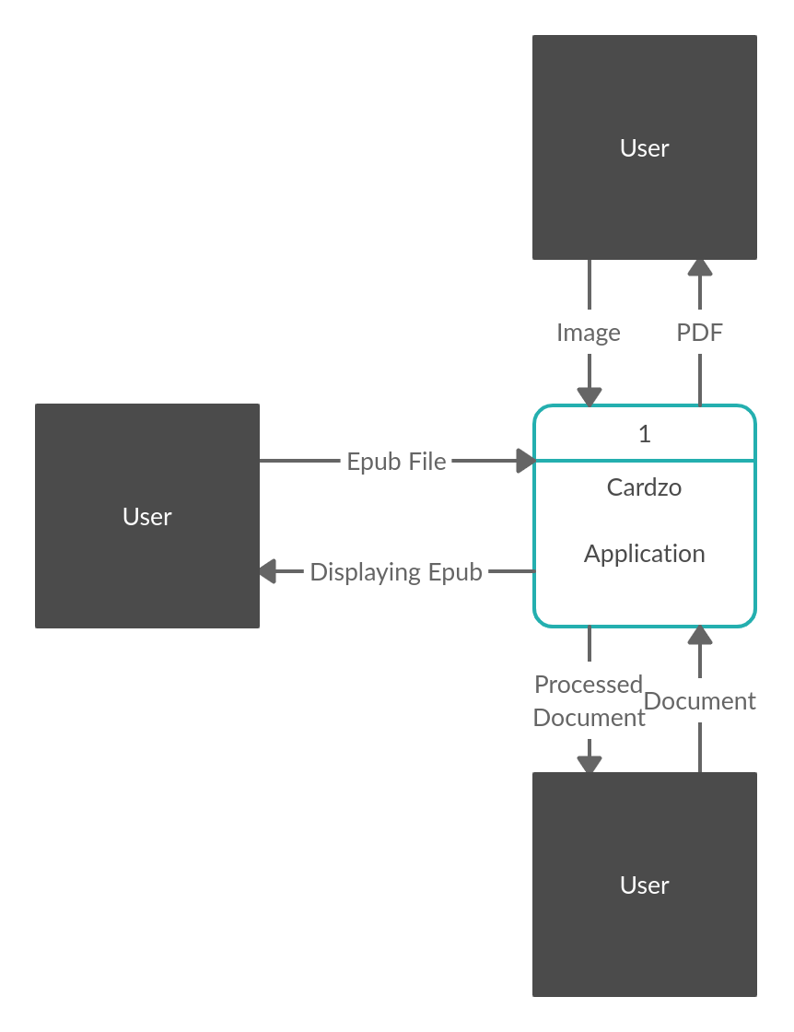
Context Diagram

Slide 14
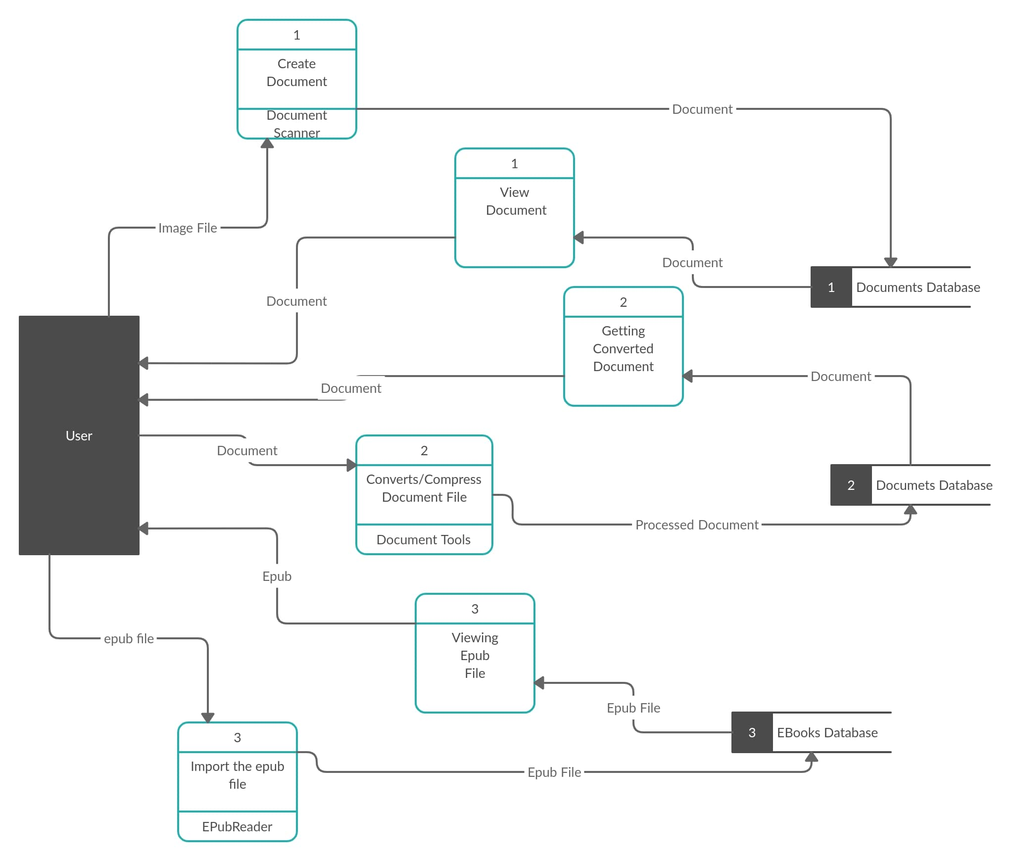
Level 1 Diagram

Slide 15
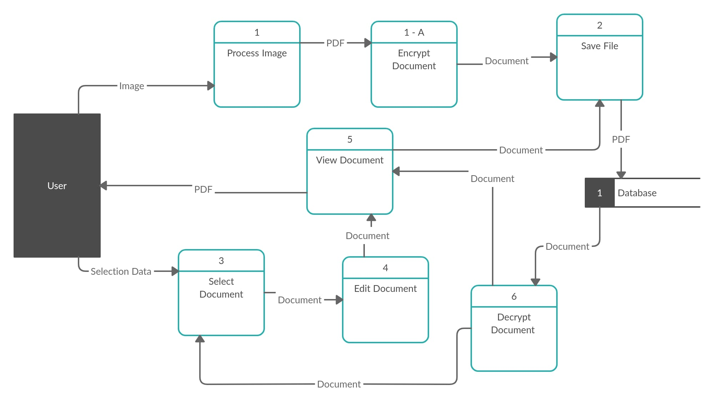
DocScanner

Slide 16
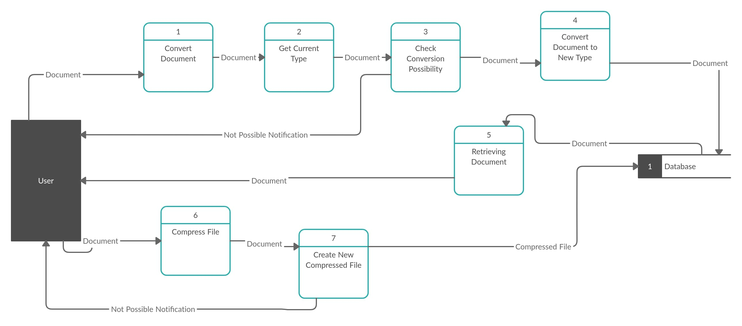
DocTools

Slide 17
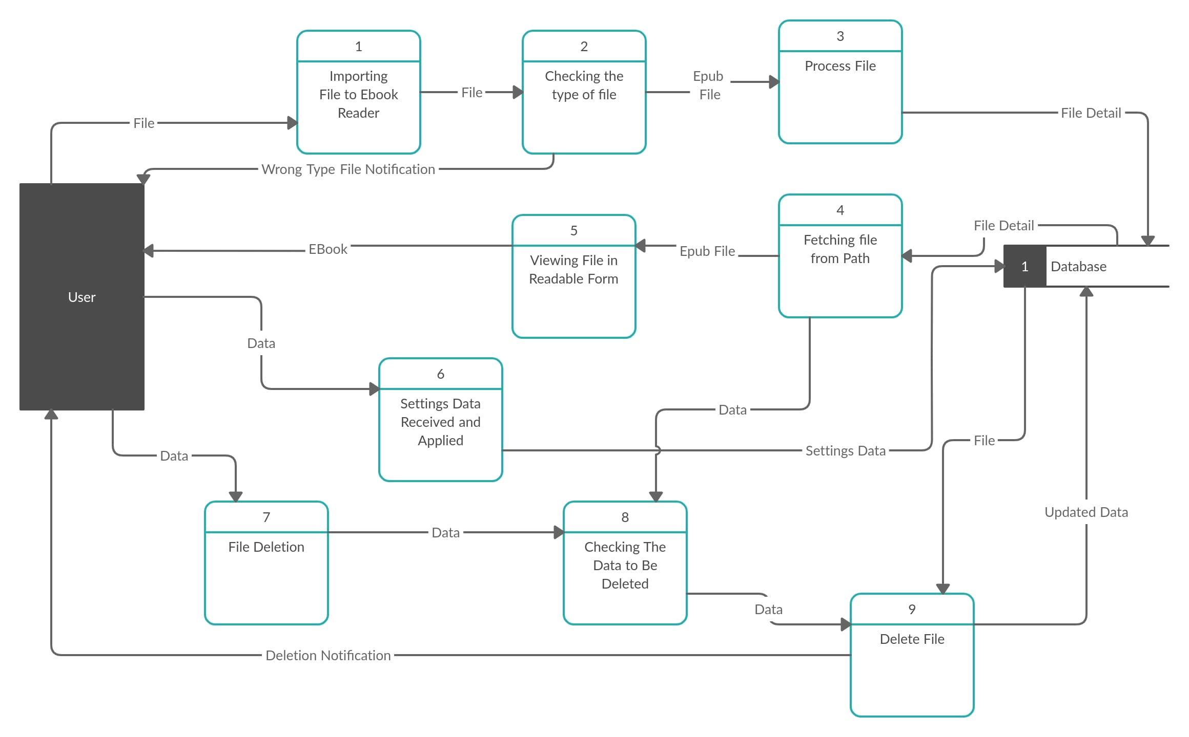
EReader

Slide 18
THANK YOU

